Slide 1

CVR COLLEGE OF ENGINEERING
(An UGC Autonomous Institution, Affiliated By JNTUH, Accredited by NBA and NACC )
DEPARTMENT OF COMPUTER SCIENCE AND ENGINEERING
Real - Time / Field - Based Research Project
BATCH NO –9
Title:-TasteTrove
Professor Incharge
Dr. M. Swami Das
Section Coordinator
T. Jyothi
Presented By:
M.DILEEP KRISHNA-23B81A0576
B.NIHAN REDDY-23B81A0589
B.PRAJEETH REDDY-23B81A0592

Slide 2
AGENDA
Abstract
Introduction
Literature Survey
Requirements Analysis
Design

Slide 3
ABSTARCT
Intuitive Platform: Taste Trove is a web-based recipe discovery tool designed to inspire home cooks.
Integrated Features: Includes in-depth recipes, shopping list views, and interactive cooking timers for a better cooking experience.
User-friendly for all skill levels: Whether a beginner or an expert, Taste Trove makes cooking enjoyable and accessible for everyone.
Keywords:powerful interface, advanced search features, popular recipes.

Slide 4
1. Introduction
Promotes Healthy Cooking: This helps the user find healthy, delicious recipes to make informed choices about meals.
User Friendly Interface: Easy design to look for recipes and track nutritional
contents.
Diverse Recipes: Offers options for various dietary needs like vegan, gluten- free, and high-protein.
Convenient & Educational: Ease of use with nutritional education for healthier cooking.
Global Reach: Encourages home cooking worldwide, balancing flavor with nutrition

Slide 5
Motivation
Healthy, Delicious Meals: It empowers the users to make choices, knowing what they are eating, is delicious.
Easy for All Cooks: Simplifies meal prep and macronutrient tracking for all skill levels.
Diverse Options: It offers recipes for various diets and health goals, thus encouraging healthier lifestyles.
Problem Statement
Challenges in Healthy Cooking: Many people struggle with healthy meal prep due to time, nutrition knowledge, and misconceptions about taste.
Easy, Nutritional Solution: Our platform simplifies finding and preparing healthy meals with personalized recipes and nutrition info.

Slide 6
Objective of the Project
Encourages Healthy Eating: Provides balanced recipes with fresh ingredients and detailed macronutrient information for informed meal preparation.
Comprehensive Nutritional Data: Provides macronutrient details for each recipe to help users align meals with their health goals.
Efficient Recipe Search: Features a quick, intuitive search function to find recipes by name.

Slide 7
Saves Time: Optimizes ingredient quantities and cooking times to make meal preparation quicker and easier without compromising quality.
Diverse Recipe Collection: It provides a wide range of recipes to cater to different tastes, dietary needs, and cultural preferences.

Slide 8
2. Literature Survey
S No | TITLE OF PROJECT | DISADVANTAGES | ADVANTAGES
1. | CookBook | Paid subscription | User friendly interface
2. | MealBoard | Complex interface
3. | Tandoor | Requires self-hosting | Unique and various dishes .
4. | BigOven | Lot of ads,some features unlock at pro | Creats user community
5. | ChefTap | Occasional syncing issues | Sync over multiple devices.
Simplifies meal planning, grocery shopping.

Slide 9
3. Requirements Analysis
Software Requirement Specifications
User Management:
Two-Factor Authentication (2FA) for user registration and login using phone and email verification.
Recipe Management:
Add, edit, and delete recipes with prompts to guide users through required fields.
Search and Filter:
Keyword-based search with results filtering and no matches notification.
Hardware Requirement Specifications
Server-Side Hardware:
Multi-core processor (e.g., Intel Xeon or AMD EPYC) with at least 2.5 GHz processing speed, 8 GB RAM, 300 GB SSD.
Client-Side Hardware:
Minimum 2 GHz dual-core processor, 4 GB RAM, 128 GB storage, stable internet connectionwith at least 5 Mbps speed.

Slide 10
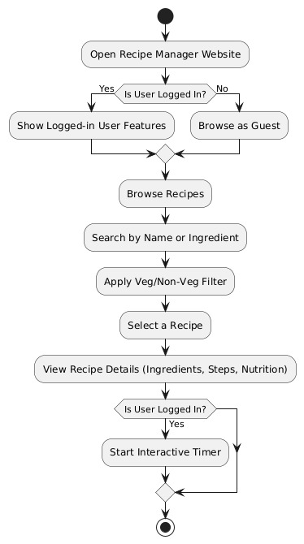
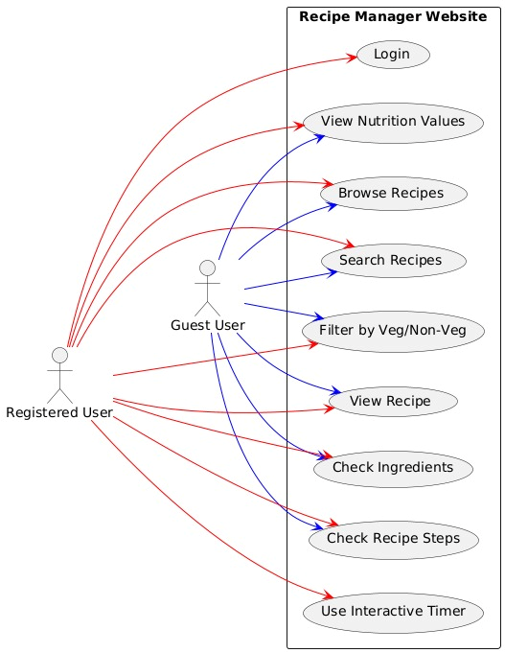
4. Design

Slide 11


